Slide 1
EER Modelling
Super classes and sub classes

Slide 2
So far we have covered
Entities
Attributes
Keys
Relationships
Constraints

Slide 3
Enhanced Entity-Relationship (EER) model
ER Diagram can’t capture Specialisation / Generalisation
Bank staff are: Managers, Supervisors, Assistants, ...
Hospital staff are: Medical staff, Admin staff, Facility staff, etc.
Medical staff are: Doctors, Nurses, Technicians, etc.
Specific staff group have particular attributes relationships
ER model cannot represent this - EER can!
Enhanced Entity-Relationship (EER) Model
an ER model with additional semantic concepts
represented in UML

Slide 4
Entity Type Hierarchy
A hierarchy contains of Subclasses and Superclasses
An entity instance of a Subclass IS A entity instance of a Superclass
Subclass – a distinct sub-grouping of occurrences of an entity type (e.g. Manager, Sales Personnel, Secretary) IS A Staff
Superclass – an entity type with distinct subclasses (e.g. Staff)
Subtypes are related to supertypes through the “IS A” relationship:
“Manager IS A Staff”
“Sales Personnel” IS A Staff”
A subclass may also have one or more subclasses, e.g.
Staff is a supertype of MedicalStaff; MedicalStaff is its subtype
MedicalStaff is supertype of Doctor; Doctor is its subtype

Slide 5
Superclass/Subclass Relationships
Each member of subclass is also a member of the superclass
all Doctor entities are MedicalStaff
Superclass may contain subclasses that are overlapping or distinct
Not all members of superclass must be member of a subclass
an entity can be MedicalStaff without belonging to a subclass

Slide 6
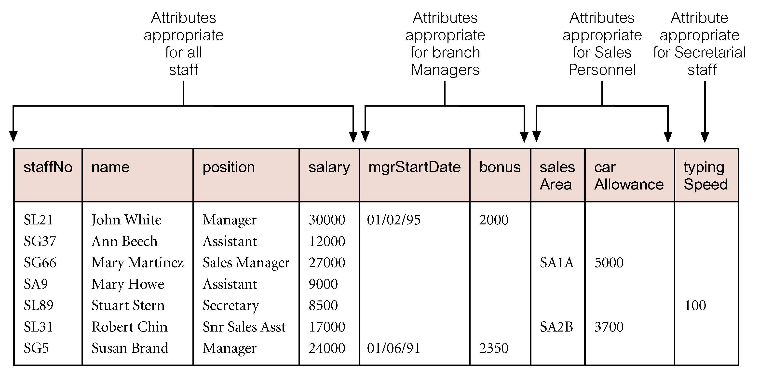
Common and Specific Attributes

Slide 7
Superclass/Subclass Attributes
Each subclass inherits all attributes of its superclass
Staff : {staffNo, name, address, salary}
Managers : {above attributes} + {mgrStartDate, Bonus}
SalesPersonnel: {above attributes} + {salesArea, carAllowance}
Secretarial staff have: {above attributes} + {typing Speed}
In EER diagram, inherited attributes only appear once
they go in the highest superclass
Multiple inheritance
a subclass may also have more than one superclass
such a subclass is called a shared subclass
the attributes of the superclasses are inherited by the shared subclass

Slide 8
Specialisation/Generalisation (S/G)
Specialisation
process of maximising differences between members of an entity by identifying their distinguishing characteristics
a top-down approach
process of identifying differences between entities that we previously grouped together
Generalisation
process of minimising differences between entities by identifying their common characteristics
a bottom-up approach
process of identifying similarities between different entities through common attributes and/or relationships

Slide 9
Constraints on S/G
{Mandatory/Optional, And/Or}
Participation constraint
determines whether every member in superclass must participate as a member of subclass: mandatory | optional
mandatory participation every member of staff must have a contract of employment
optional participation a member of staff need not to have an additional job role
Disjoint constraint
describes relationship between members of the subclasses and indicates whether a member of a superclass can be a member of one, or more than one, subclass
may be disjoint {Or} or non-disjoint {And}.

Slide 10
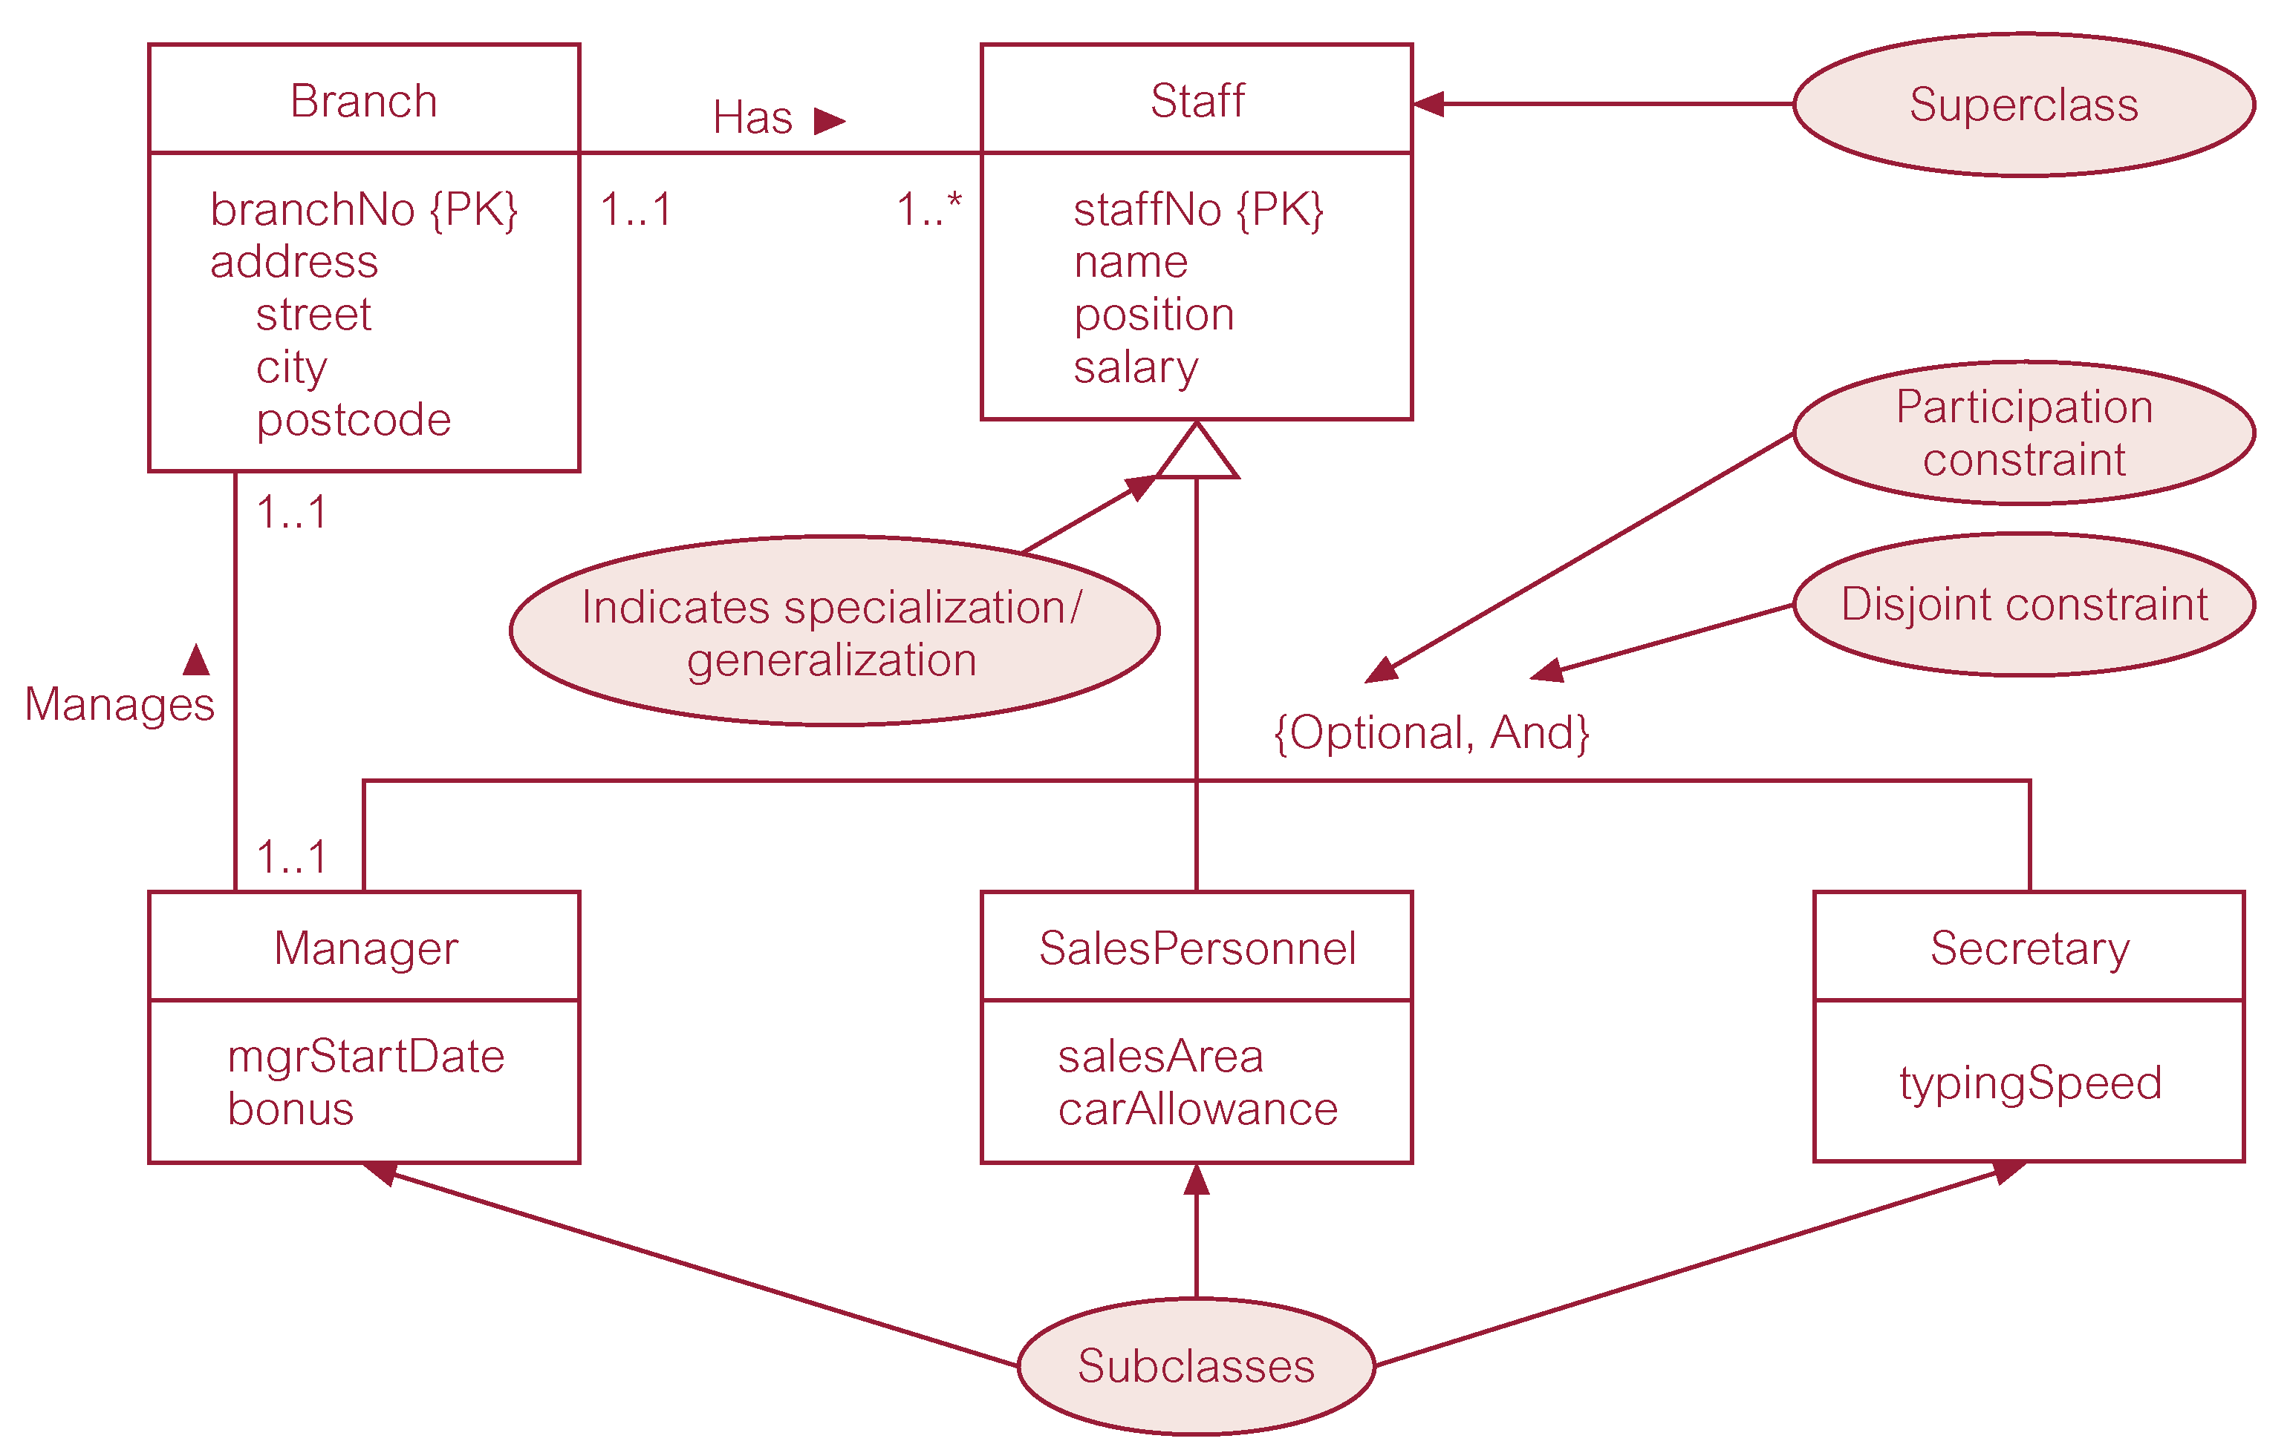
S/G of Staff Entity: Job Role Subclasses

Slide 11
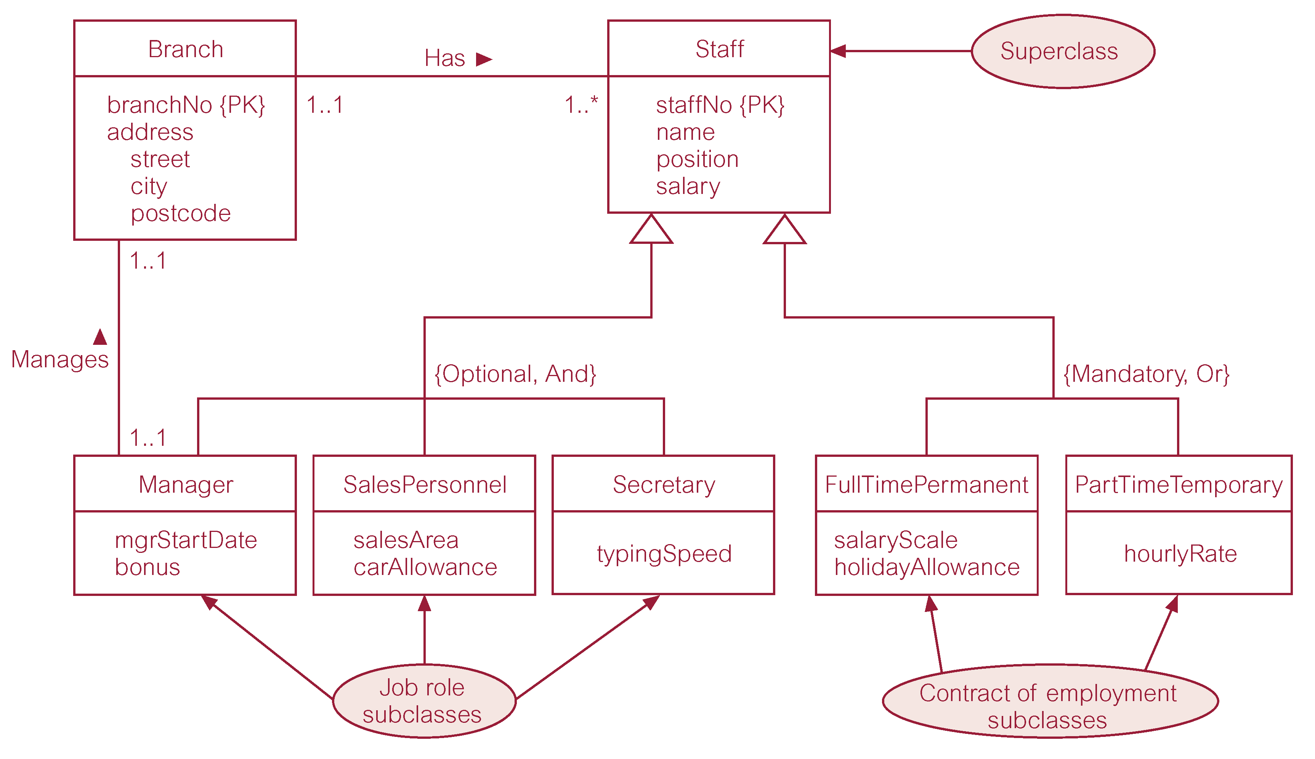
S/G of Staff Entity: Job Roles & Contracts

Slide 12
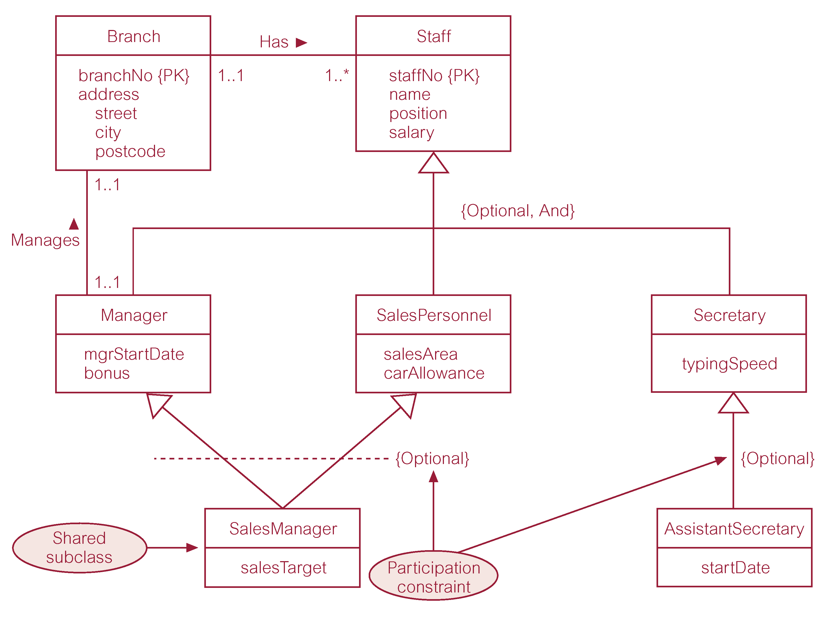
More on Subclasses
shared Subclass
subclass with its own Subclass

